Slide 1
Summary of data for Sigmodon hispidus at Hall’s Cave Site

Slide 2
Summary of Data
Lower age range | Upper age range | mean age | age range | Level | depths included | N (mass) | N (SIA) | Mean Mass (g) | StDev Mass | Mean delta 13C | StDev delta 13C | Mean 15N | StDev 15N | SEA
0 | 1458 | 729 | 1458 | 1 | 0-10 | 18 | 13 | 87.84 | 21.54 | -17.35 | 2.62 | 5.63 | 1.36 | 10.52
1458 | 2775 | 2116.5 | 1317 | 2 | 10-30 | 22 | 26 | 88.05 | 19.34 | -17.70 | 2.02 | 5.31 | 0.82 | 5.20
3104 | 4422 | 3763 | 1318 | 3 | 30-60 | 7 | 7 | 91.26 | 10.08 | -18.16 | 2.64 | 6.20 | 1.16 | 9.15
4751 | 5410 | 5080.5 | 659 | 4 | 60-70 | 14 | 13 | 82.58 | 19.87 | -17.02 | 2.34 | 6.48 | 1.01 | 5.90
5410 | 6069 | 5739.5 | 659 | 5 | 70-80 | 20 | 28 | 88.37 | 13.55 | -16.63 | 2.80 | 5.74 | 0.80 | 6.31
6069 | 6398 | 6233.5 | 329 | 6 | 80-85 | 21 | 29 | 86.75 | 15.67 | -16.60 | 2.61 | 5.87 | 0.91 | 5.76
6398 | 6728 | 6563 | 330 | 7 | 85-90 | 29 | 15 | 92.06 | 15.55 | -17.03 | 2.78 | 6.09 | 0.64 | 5.63
6728 | 7716 | 7222 | 988 | 8 | 90-105 | 21 | 25 | 83.70 | 15.95 | -17.60 | 2.80 | 6.12 | 0.93 | 7.52
7716 | 8045 | 7880.5 | 329 | 9 | 105-110 | 19 | 12 | 85.50 | 19.38 | -14.57 | 2.23 | 7.19 | 1.42 | 9.17
8045 | 8375 | 8210 | 330 | 10 | 110-115 | 16 | 14 | 89.74 | 15.94 | -15.91 | 2.46 | 7.27 | 1.31 | 9.84
8375 | 8704 | 8539.5 | 329 | 11 | 115-120 | 0 | 23 |  |  | -16.05 | 2.75 | 7.00 | 1.02 | 7.77
8704 | 9033 | 8868.5 | 329 | 12 | 120-125 | 16 | 11 | 89.41 | 20.94 | -16.15 | 3.60 | 6.95 | 1.63 | 10.81
9033 | 9363 | 9198 | 330 | 13 | 125-130 | 22 | 15 | 81.43 | 17.83 | -16.49 | 2.63 | 6.75 | 0.81 | 6.26
9363 | 9692 | 9528 | 329 | 14 | 130-135 | 22 | 13 | 87.66 | 14.47 | -17.45 | 2.26 | 6.85 | 1.51 | 8.58
9692 | 10021 | 9857 | 329 | 15 | 135-140 | 22 | 8 | 88.34 | 17.82 | -14.51 | 3.02 | 6.91 | 1.07 | 6.34
10021 | 10351 | 10186 | 330 | 16 | 140-145 | 45 | 11 | 87.62 | 16.80 | -15.09 | 2.91 | 6.95 | 0.81 | 6.98
10351 | 11668 | 11010 | 1317 | 17 | 145-165 | 27 | 21 | 87.56 | 19.43 | -17.78 | 3.65 | 6.76 | 1.22 | 10.17
11668 | 13050 | 12359 | 1382 | 18 | 165-180 | 7 | 7 | 84.03 | 20.45 | -13.96 | 2.41 | 7.24 | 0.83 | 6.26
13915 | 15095 | 14505 | 1180 | 19 | 190-230 | 14 | 15 | 87.83 | 18.36 | -16.35 | 2.58 | 6.63 | 1.04 | 6.70
11668 | 15095 | 13382 | 3427 |  | 165-220 | 15 | 16 | 76.90 | 14.76 | -16.67 | 3.83 | 7.08 | 1.29

Slide 3
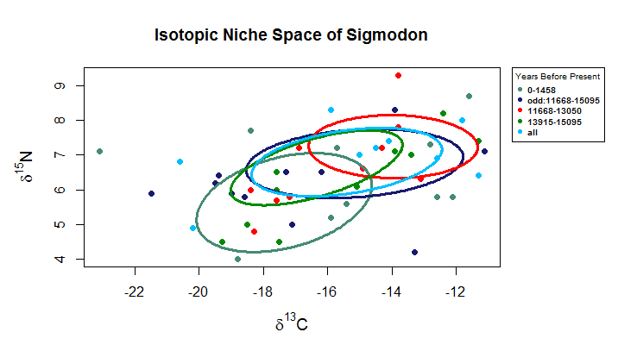
Notes:
This graph represents how the SEAs shift when including or excluding the bins that stretch between 160-220 and 170-220 to the last time bin included in the analysis.
The youngest time bin, 0-1458, is included for reference.
“Odd: 11668-15095” is the 160-220 and 170-220 plotted by themselves.
“All” indicates that the data from every bin that spans between 160 and 220 has been grouped.
The 11668-13050 and 13915-15095 are the older times bins according to the 19 bin division of the isotope data plotted with the 160-220 and 170-220 bins removed.
The 160-225 isotope data is much wider than either of the other two bins and placing them as a single set noticeably distorts the possible shift seen between these two periods. Because this bin is twice as large in time range than the next largest bin, I opted to remove it from the other graphs and thus the data we have for samples with this binning id are not included in the following slides.

Slide 4
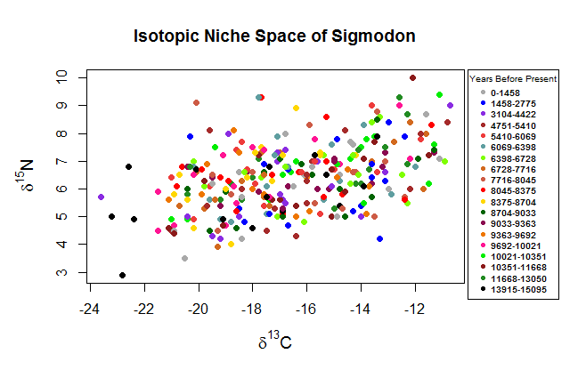

Slide 5
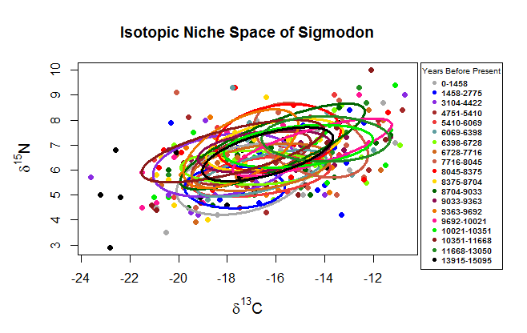

Slide 6
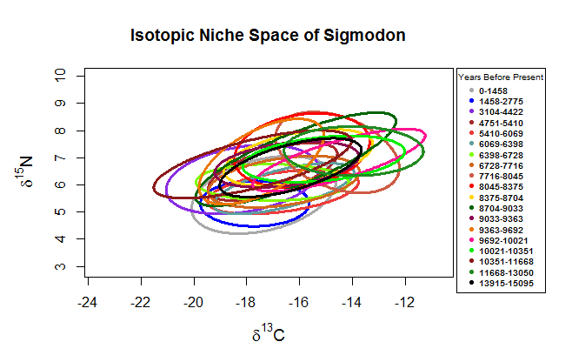

Slide 7
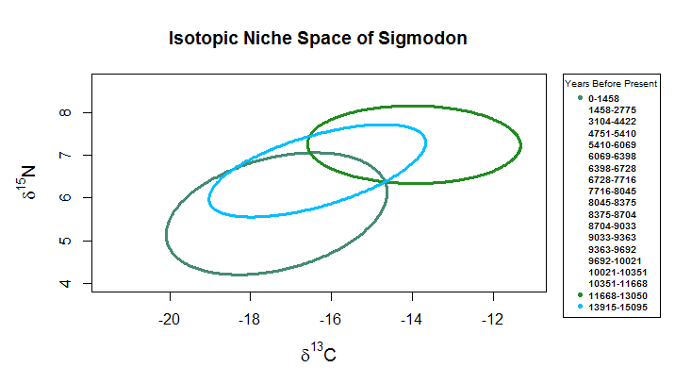

Slide 8
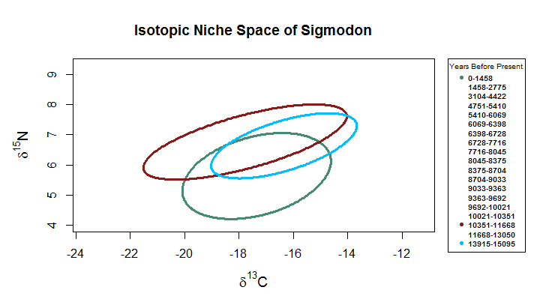

Slide 9
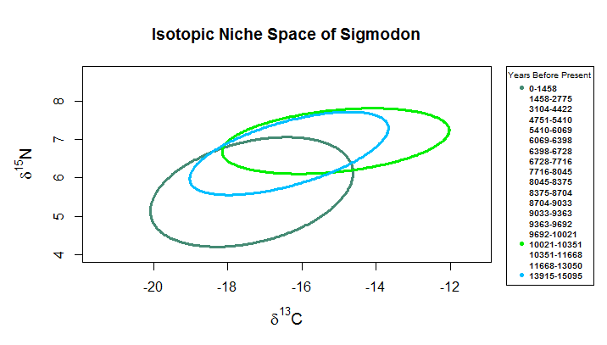

Slide 10
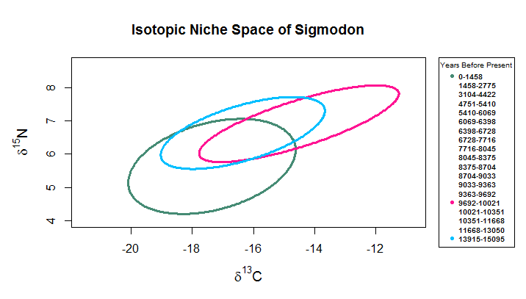

Slide 11
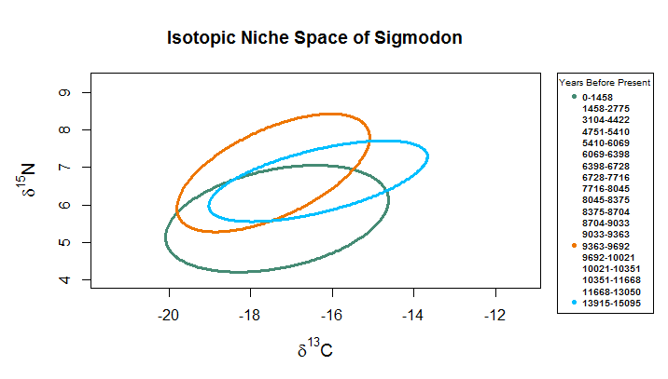

Slide 12
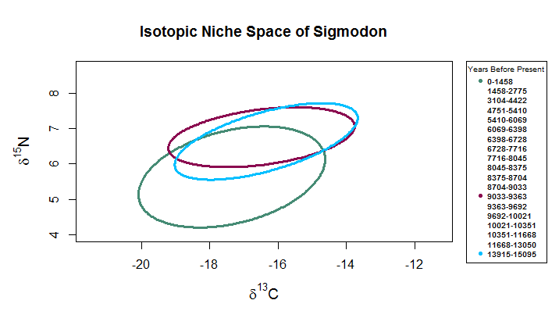

Slide 13
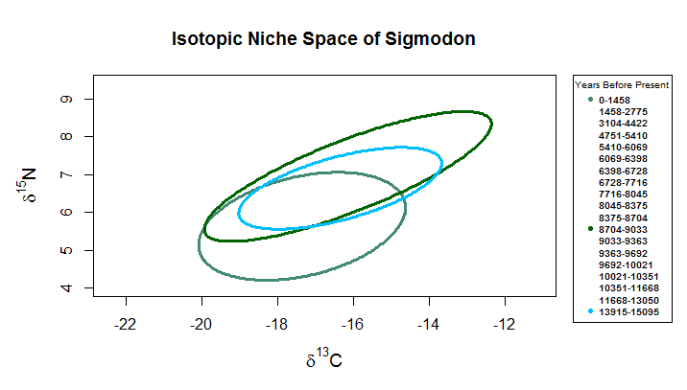

Slide 14
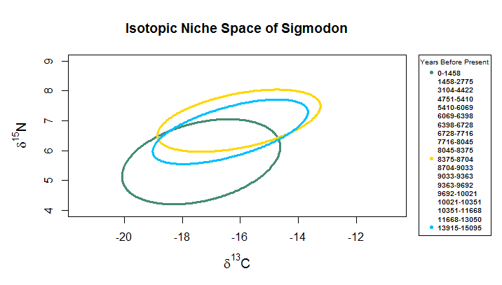

Slide 15
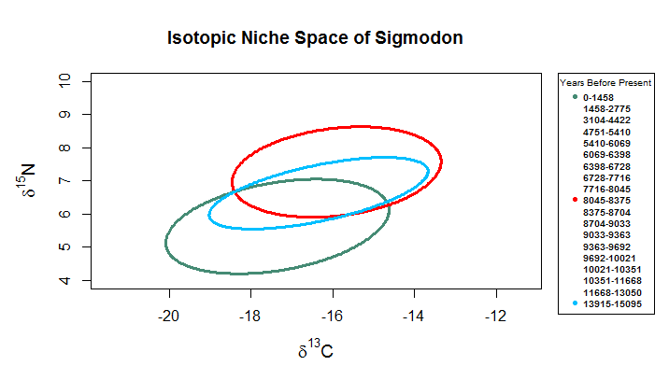

Slide 16
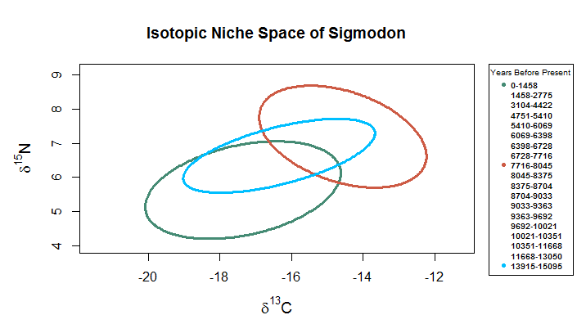

Slide 17
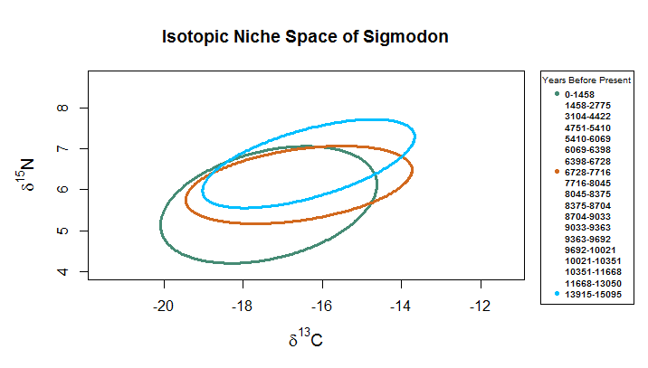

Slide 18
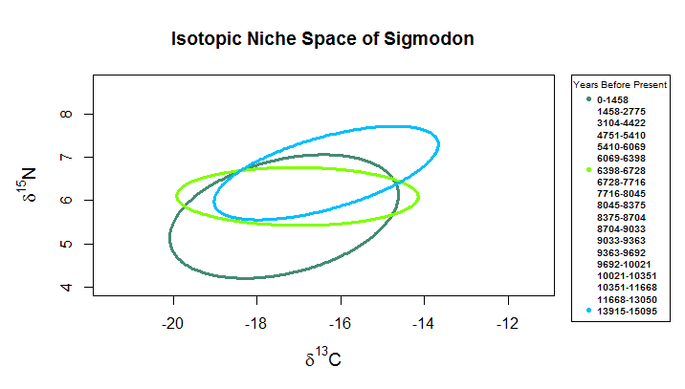

Slide 19
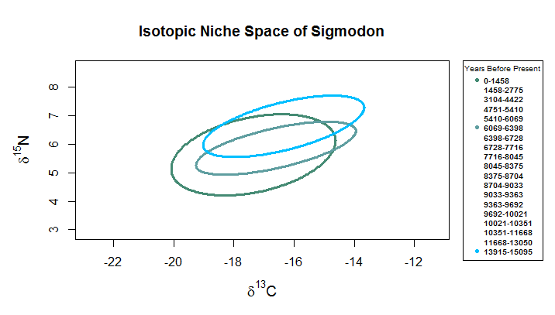

Slide 20
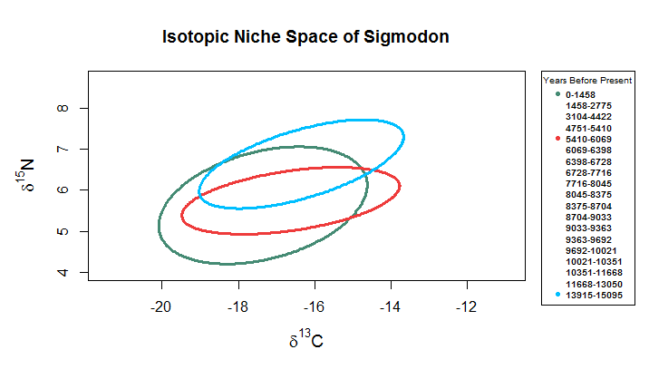

Slide 21
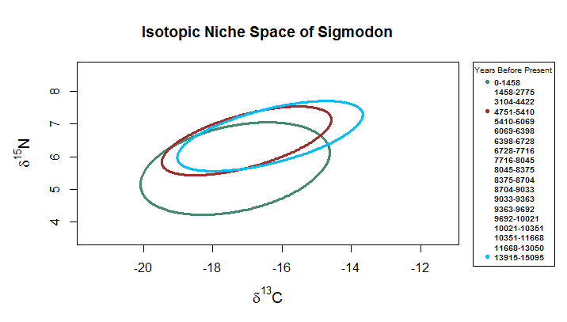

Slide 22
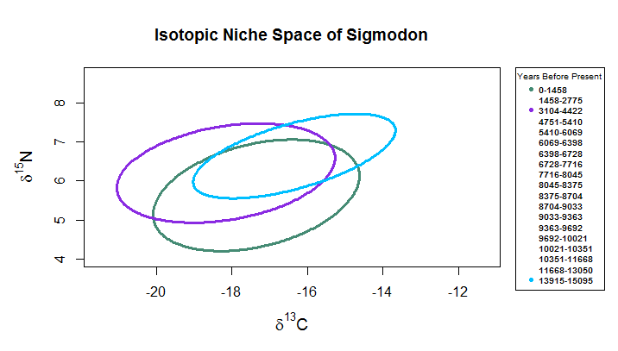

Slide 23
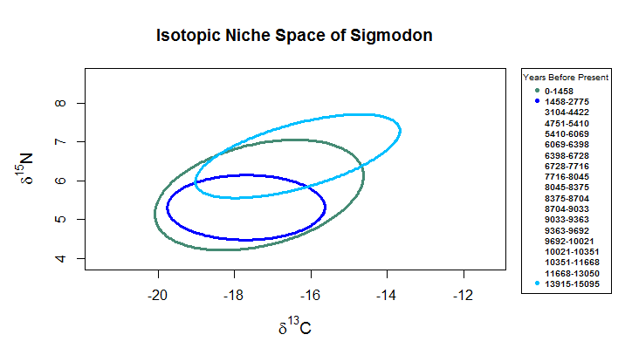

Slide 24
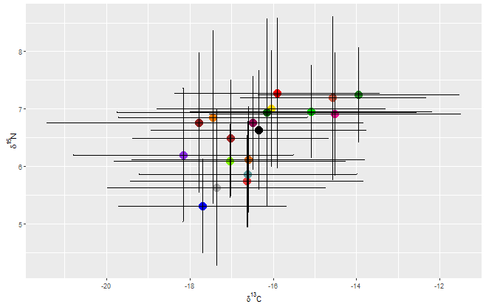
Bars = standard deviation

Slide 25
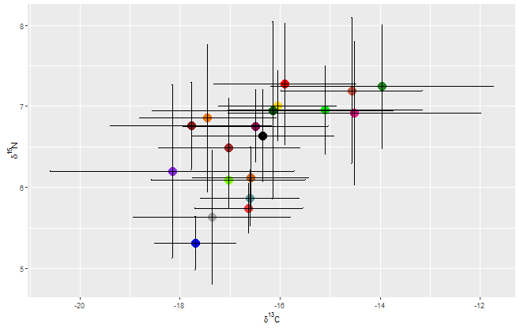
Bars = 95% confidence intervals

Slide 26
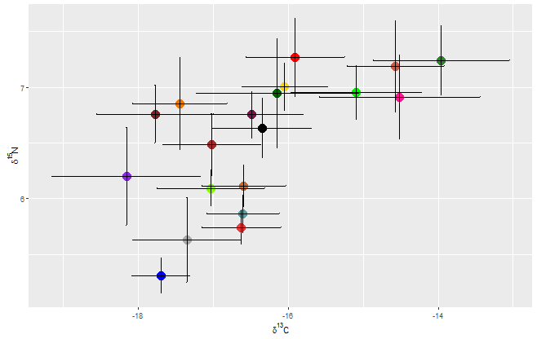
Bars = standard error

Slide 27
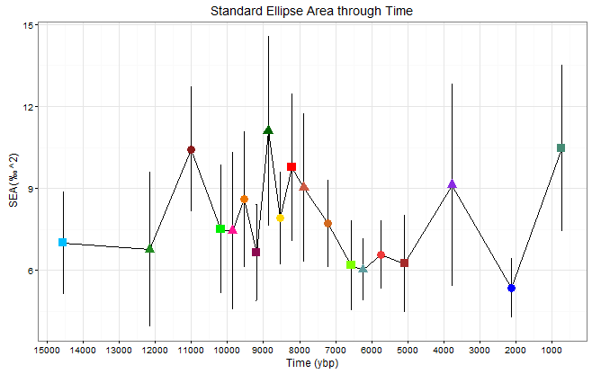
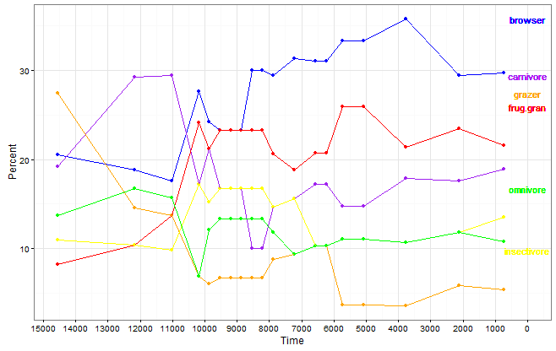
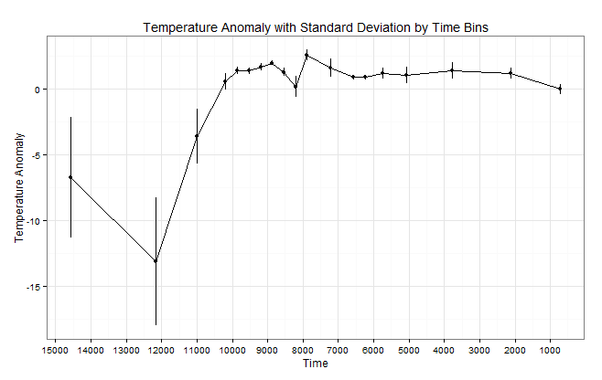

Slide 28
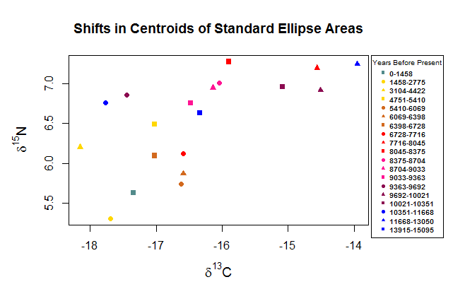

Slide 29
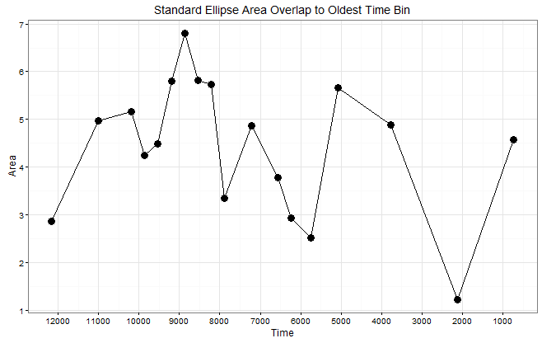
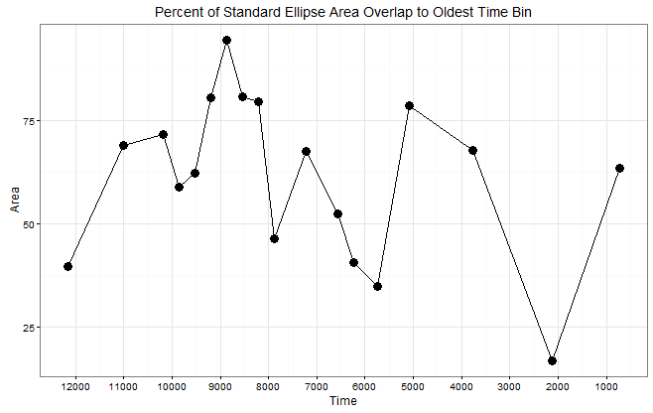
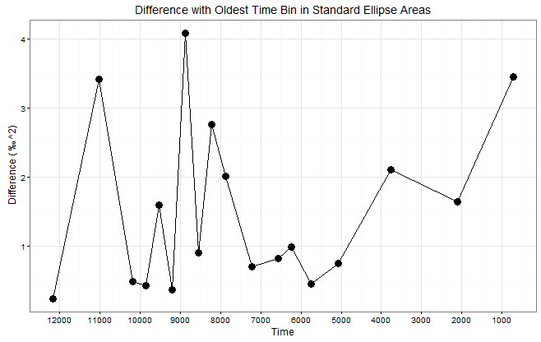

Slide 30
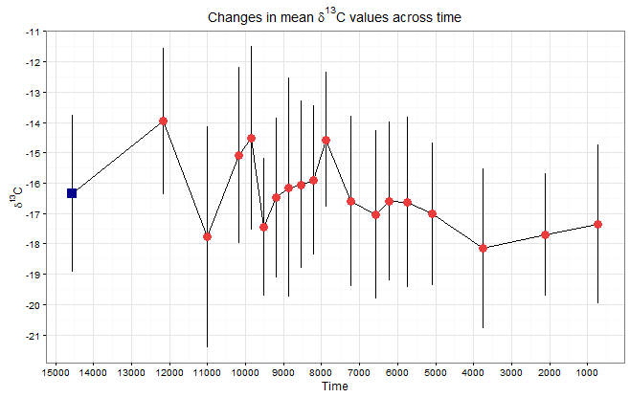
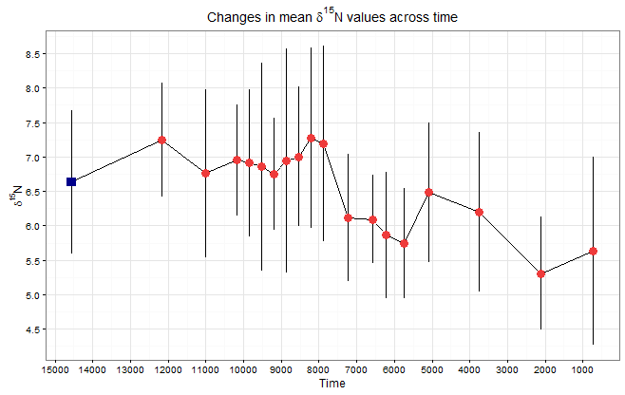

Slide 31
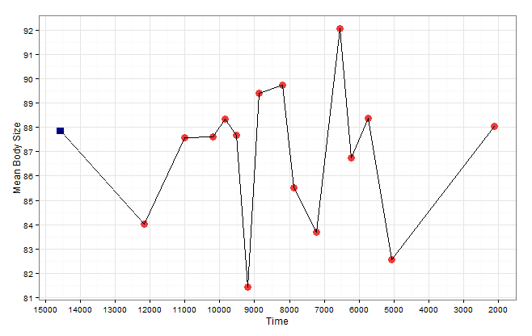

Slide 35
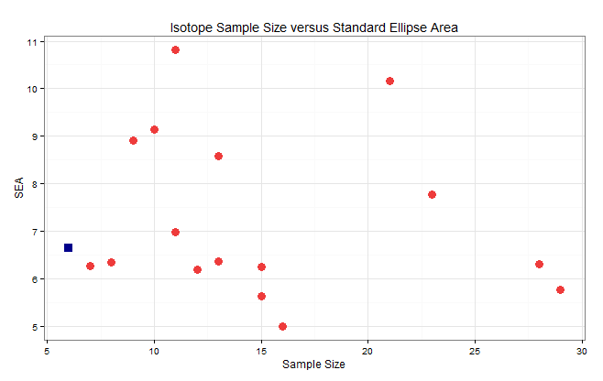
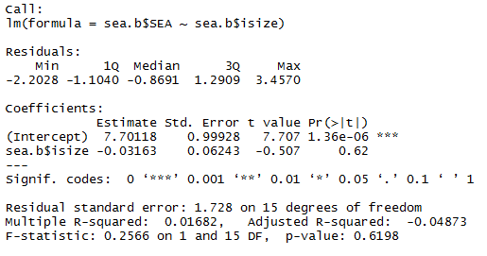
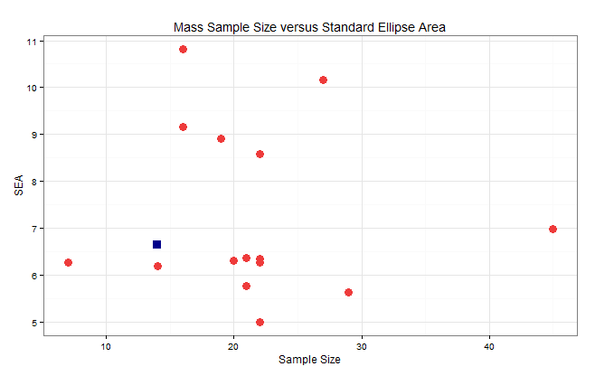
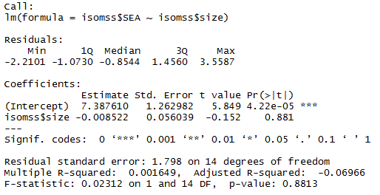

Slide 36
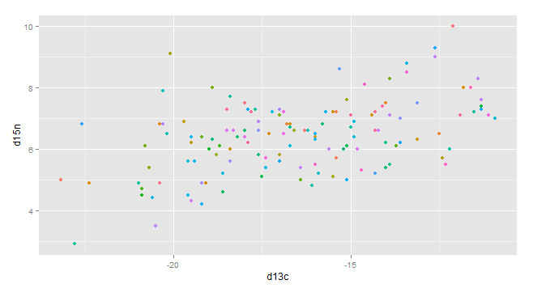
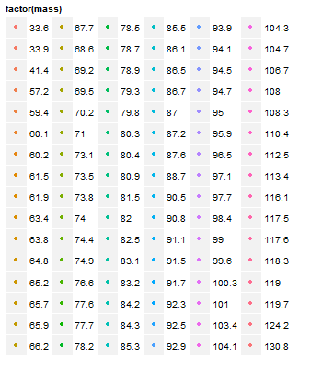
Isotope Niche with Body Mass Groups for Individuals with both values

Slide 37
Includes all 19 bins

Slide 38
Change in mean carbon and nitrogen with time
Dcarbon dnitrogen plot of individuals with mass and isotopes
Mean body mass to standard ellipse
Mean body mass to mean carbon and nitrogen

